Slide 1
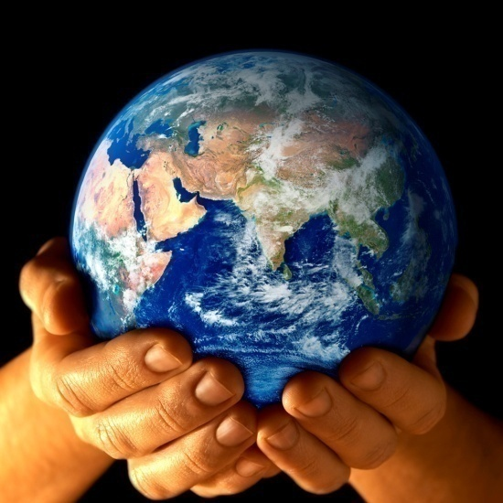
Sustainable Development
The term sustainable development refers to the development that meets the needs of the present without compromising the ability of the future generations to meet their own needs.
The concept of sustainable development can be interpreted in many different ways, but at its core is an approach to development that looks to balance different, and often competing, needs against an awareness of the environmental, social and economic limitations we face as a society.
All too often, development is driven by one particular need, without fully considering the wider or future impacts. We are already seeing the damage this kind of approach can cause, from large-scale financial crises caused by irresponsible banking, to changes in global climate resulting from our dependence on fossil fuel-based energy sources.

Slide 2
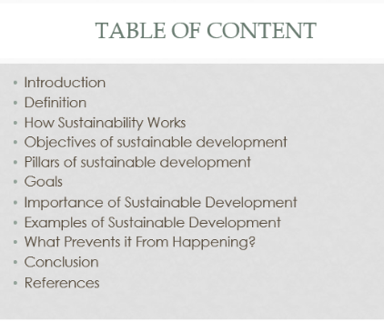

Slide 3
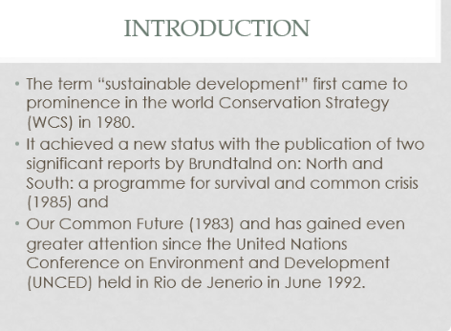

Slide 4
What is sustainable development?
The development that meets the needs of the present without compromising the ability of future generations to meet their own needs.
B. To conserve natural resources and to develop alternate sources of power while reducing pollution and harm to the environment.
C. It is the practice of developing land and construction projects in a manner that reduces their impact on the environment by allowing them to create energy efficient models of self-sufficiency.
D. All of the above

Slide 5
What are the Primary Goals of Sustainability?
I. The end of poverty and hunger
II. Better standards of education and healthcare - particularly as it pertains to water quality and better sanitation
III. To achieve gender equality
IV. Sustainable economic growth while promoting jobs and stronger economies
Code:
I, II & III
B. I, III & IV
C. I & III
D. I, II, III & IV

Slide 6
When was the term ‘Sustainable Development’ came into existence?
A. 1987
B. 1980
C. 1978
D. 1992

Slide 7
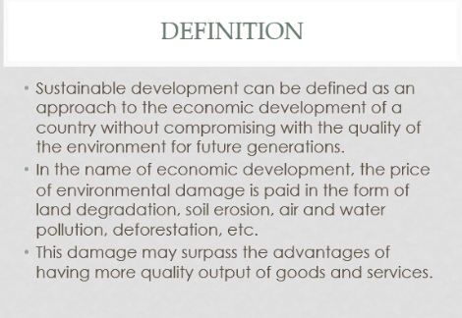

Slide 8
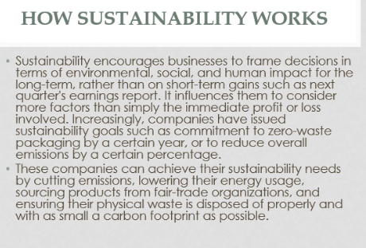

Slide 9
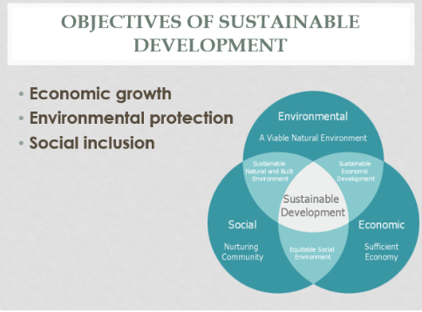

Slide 10
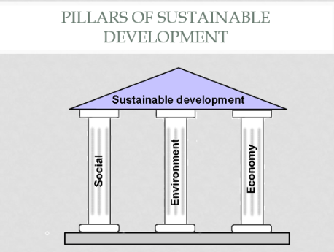

Slide 11
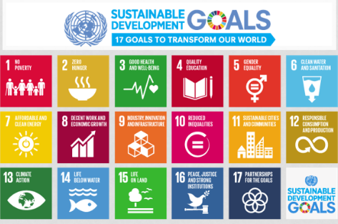

Slide 12
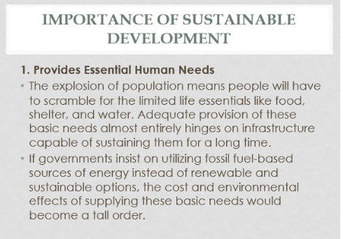

Slide 14
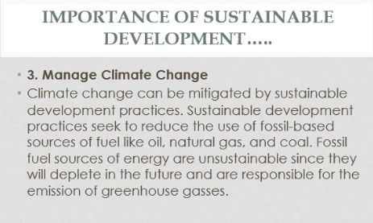

Slide 15
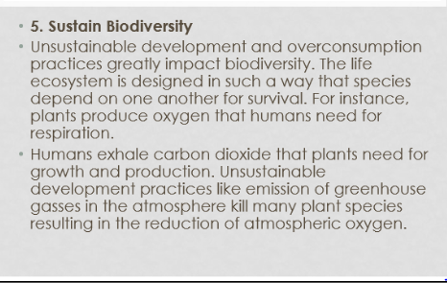

Slide 16
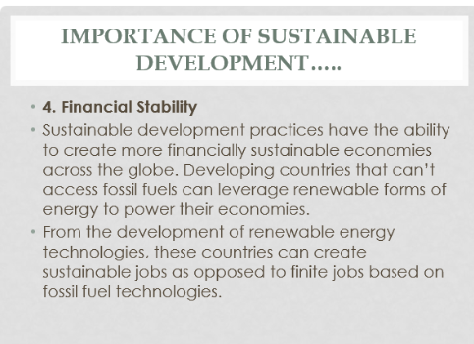

Slide 17
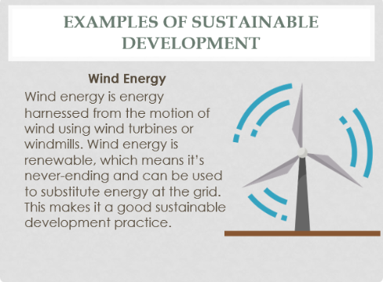

Slide 18
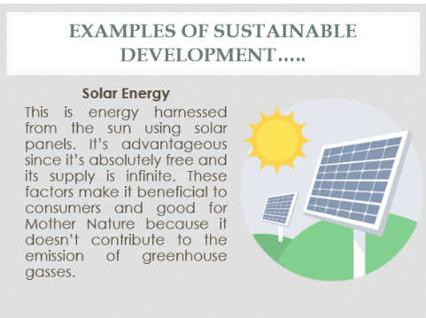

Slide 19
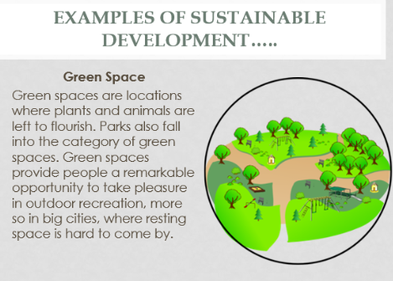

Slide 20
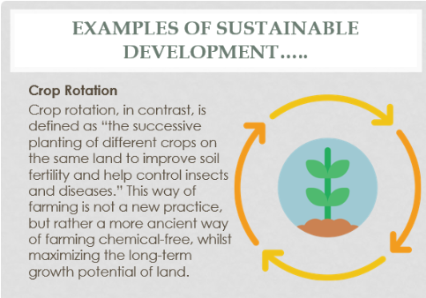

Slide 21
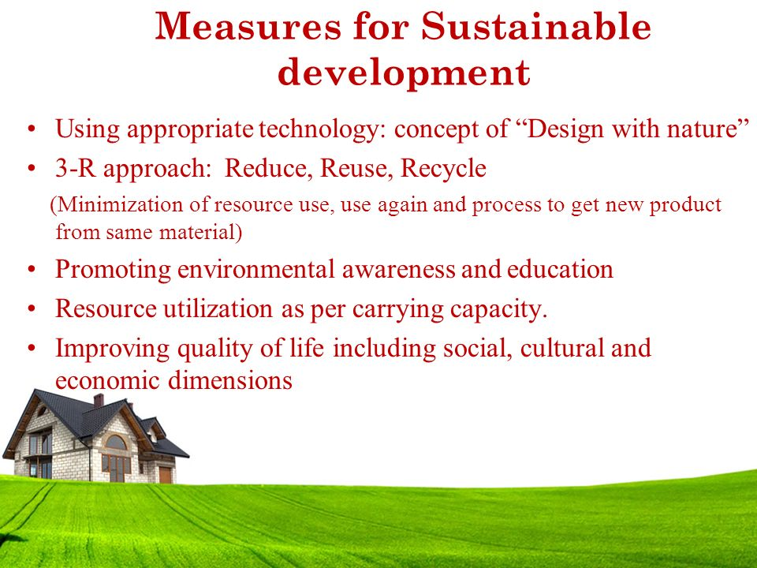

Slide 22
